Slide 1
Software Testing Life Cycle
Software Testing
Lecture 4

Slide 2
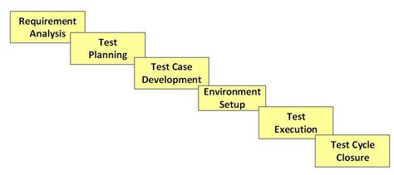
Software Testing Life Cycle(STLC)

Slide 3
Software Testing Life Cycle
Software Testing Life Cycle (STLC) is defined as a sequence of activities conducted to perform Software Testing.
It consists of series of activities carried out methodologically to help certify your software product.
Each of these stages have a definite Entry and Exit criteria; , Activities & Deliverables associated with it.
Entry Criteria: Entry Criteria gives the prerequisite items that must be completed before testing can begin.
Exit Criteria: Exit Criteria defines the items that must be completed before testing can be concluded

Slide 4
Requirement Traceability Matrix (RTM)
RTM captures all requirements proposed by the client or software development team and their traceability in a single document delivered at the conclusion of the life-cycle.
In other words, it is a document that maps and traces user requirement with test cases.
The main purpose of RTM is to see that all test cases are covered so that no functionality should miss while doing Software testing.
Why RTM is Important?
The main agenda of every tester should be to understand the client’s requirement and make sure that the output product should be defect-free. To achieve this goal, every QA should understand the requirement thoroughly and create positive and negative test cases.

Slide 5
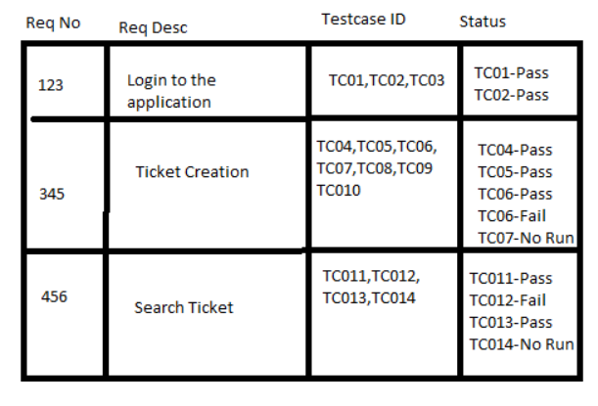
RTM Example

Slide 6
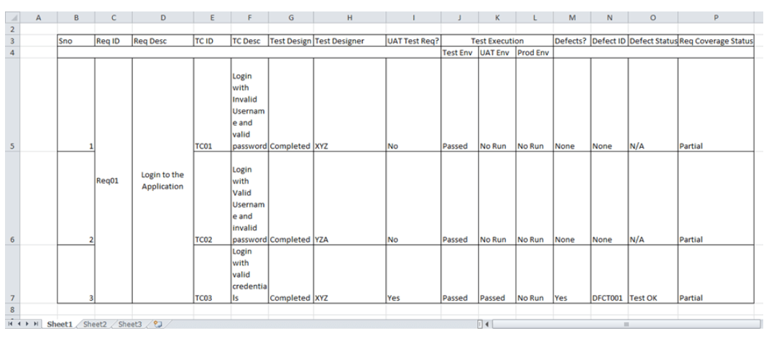
Other Parameters in RTM

Slide 7
RTM Can
Show the requirement coverage in the number of test cases
Design status as well as execution status for the specific test case
If there is any User Acceptance Test to be done by the users, then UAT status can also be captured in the same matrix.
The related defects and the current state can also be mentioned in the same matrix.

Slide 8
STLC Phases
STLC Stage | Entry Criteria | Activity | Exit Criteria | Deliverables
Requirement Analysis | Requirements Document available (both functional and non functional) Acceptance criteria defined. Application architectural document available. | Analyze business functionality to know the business modules and module specific functionalities. Identify all transactions in the modules. Identify all the user profiles. Gather user interface/ authentication, geographic spread requirements. Identify types of tests to be performed. Gather details about testing priorities and focus. Prepare Requirement Traceability Matrix (RTM). Identify test environment details where testing is supposed to be carried out. Automation feasibility analysis (if required). | Signed off RTM Test automation feasibility report signed off by the client | RTM Automation feasibility report (if applicable

Slide 9
STLC Phases
STLC Stage | Entry Criteria | Activity | Exit Criteria | Deliverables
Test Planning | Requirements Documents Requirement Traceability matrix. Test automation feasibility document. | Analyze various testing approaches available Finalize on the best-suited approach Preparation of test plan/strategy document for various types of testing Test tool selection Test effort estimation Resource planning and determining roles and responsibilities. | Approved test plan/strategy document. Effort estimation document signed off. | Test plan/strategy document. Effort estimation document.

Slide 10
STLC Phases
STLC Stage | Entry Criteria | Activity | Exit Criteria | Deliverables
Test case development | Requirements Documents RTM and test plan Automation analysis report | Create test cases, test design, automation scripts (where applicable) Review and baseline test cases and scripts Create test data | Reviewed and signed test Cases/scripts Reviewed and signed test data | Test cases/scripts Test data

Slide 11
STLC Phases
STLC Stage | Entry Criteria | Activity | Exit Criteria | Deliverables
Test Environment setup | System Design and architecture documents are available Environment set-up plan is available | Understand the required architecture, environment set-up Prepare hardware and software development requirement list Finalize connectivity requirements Prepare environment setup checklist Setup test Environment and test data Perform smoke test on the build Accept/reject the build depending on smoke test result | Environment setup is working as per the plan and checklist Test data setup is complete Smoke test is successful | Environment ready with test data set up Smoke Test Results.

Slide 12
STLC Phases
STLC Stage | Entry Criteria | Activity | Exit Criteria | Deliverables
Test Cycle closure | Testing has been completed Test results are available Defect logs are available | Evaluate cycle completion criteria based on - Time, Test coverage, Cost, Software Quality, Critical Business Objectives Prepare test metrics based on the above parameters. Document the learning out of the project Prepare Test closure report Qualitative and quantitative reporting of quality of the work product to the customer. Test result analysis to find out the defect distribution by type and severity | Test Closure report signed off by client | Test Closure report Test metrics

Slide 13
STLC Phases
STLC Stage | Entry Criteria | Activity | Exit Criteria | Deliverables
Test Execution | Baselined RTM, Test Plan , Test case/scripts are available Test environment is ready Test data set up is done Unit/Integration test report for the build to be tested is available | Execute tests as per plan Document test results, and log defects for failed cases Update test plans/test cases, if necessary Map defects to test cases in RTM Retest the defect fixes Regression Testing of application Track the defects to closure | All tests planned are executed Defects logged and tracked to closure | Completed RTM with execution status Test cases updated with results Defect reports

Slide 14
Software Testing Activities

Slide 15
V Model
The V-model is a type of SDLC model where process executes in a sequential manner in V-shape.
Each phase must be completed before the next phase begins.
Testing of the phase is planned in parallel with corresponding phase of development in V model.

Slide 16
V Model
The V-Model is a unique, linear development methodology used during a SDLC.
V model is also known as Verification and Validation model.
Testing phase goes in parallel with the development phase.
Testing phase starts right at the beginning of SDLC.

Slide 17
V-Model
Developers Life Cycle
(Verification)
Tester’s Life Cycle
(Validation)
03167100319
Fig. V-Model

Slide 18
Verification & Validation
Verification | Validation
The process of determining whether the products of a given phase of the software development process fulfill the requirements established during the previous phase. OR Verification addresses the concern: "Are you building it right?“ or if we are in the right track of creating the final product. | The process of evaluating software at the end of software development to ensure compliance with intended usage OR Validation addresses the concern: "Are you building the right thing?“
Ensures that the software system meets all the functionality. | Ensures that the functionalities meet the Proposed behavior.
Verification takes place first and includes the checking for documentation, code, etc. | Validation occurs after verification and mainly involves the checking of the overall product.
Done by developers. | Done by testers.
It has static activities, as it includes collecting reviews, walkthroughs, and inspections to verify a software. | It has dynamic activities, as it includes executing the software against the requirements.

Slide 19
V Model
Typical V-model shows Software Development activities on the Left hand side of model and the Right hand side of the model actual Testing Phases can be performed.
In this process “Do-Procedure” would be followed by the developer team and the “Check-Procedure” would be followed by the testing team to meets the mentioned requirements.
The V-model typically consist of the following phases:
1. Acceptance Testing : assess software with respect to requirements or users’
needs.
2. System Testing : assess software with respect to architectural design and overall
behavior.
3. Integration Testing : assess software with respect to subsystem design.
4. Module Testing: assess software with respect to detailed design.
5. Unit Testing : assess software with respect to implementation.

Slide 20
V-Model
Requirement Analysis:
The requirements analysis phase of software development captures the customer’s needs.
Acceptance testing is designed to determine whether the completed
software in fact meets these needs.
Acceptance testing probes whether the software does what the users want.
Architectural Design
This step maps requirements onto functions and dialogues of the new system.
It’s the phase where system engineers analyze and understand the business of the proposed system by studying the user requirements document.
They figure out possibilities and techniques by which the user requirements can be implemented. If any of the requirements are not feasible, the user is informed of the issue.

Slide 21
V-Model
Architectural Design:
System testing is designed to determine whether the assembled system meets its specifications.
It assumes that the pieces work individually and asks if the system works as a whole.
This level of testing usually looks for design and specification problems.
Subsystem Design:
The subsystem design phase of software development specifies the structure and behavior of subsystems, each of which is intended to satisfy some function in the overall architecture. Often, the subsystems are adaptations of previously developed software.
Integration testing is designed to assess whether the interfaces between modules (defined below) in a subsystem have consistent assumptions and communicate correctly.
Integration testing must assume that modules work correctly. Some testing literature uses the terms integration testing and system testing interchangeably.

Slide 22
V-Model
Detailed Design:
The detailed design phase of software development determines the structure and behavior of individual modules. A module is a collection of related units that are assembled in a file, package, or class.
Module testing is designed to assess individual modules in isolation, including how the component units interact with each other and their associated data structures.
Most software development organizations make module testing the responsibility of the programmer; hence the common term developer testing.
Implementation:
It’s a phase of software development that actually produces code. A program unit, or procedure, is one or more contiguous program statements, with a name that other parts of the software use to call it.
Unit testing is designed to assess the units produced by the implementation phase and is the “lowest” level of testing.

Slide 23
V Model Basic Idea/Characteristics
Implementation and testing activities are separated but are equally important (left side / right side).
The V illustrates the testing aspects of verification and validation.
We distinguish between different test levels, where each test level is testing “against” its corresponding development level.

Slide 24
V-Model Advantages
Each phase of development is tested before moving to next phase, hence there is higher rate of success.
It avoids down word flow of defects because each phase is verified explicitly.
The model has clear and defined steps. So, it is easier to implement.
It is suitable for smaller projects where requirements are easily understood and fixed.
It saves a lot of time.

Slide 25
Disadvantages of V-Model
The testing team starts in parallel with development. Hence, the overall budget and resource usage increases.
Change in requirement are difficult to incorporate. Because if any changes happens, then the test requirement document must be updated.
Guessing the error in the beginning of the project could take more time.
The working model of the software is only available in the later phases of the development.
It is not suitable for complex and large applications because of its rigid process.

Slide 26
When to use the V-model?
The V-shaped model should be used for small to medium sized projects where requirements are clearly defined and fixed.
V Model should be followed for the project where very less probability to make the changes in the middle of testing or development phase which are unplanned.
The V-Shaped model should be chosen when sufficient technical resources are available with needed technical expertise.
High confidence of customer is required for choosing the V-Shaped model approach. Since, no prototypes are produced, there is a very high risk involved in meeting customer expectations.

Slide 27
Thank you

